Slide 1
Final Project – Health Information Exchange: Technology, Challenges & Opportunities
Group 3 Gary Brown, Michelle Burke, Kazi Russell
MMI 402 Fall 2013

Slide 2
Health Information Exchange (HIE):
HIE refers to the technology, standards, and governance that enables the exchange of data between various healthcare stakeholders.
An HIE is multidirectional: It is used to exchange a patient’s health data between two or more care providers.
A freestanding radiology center can use an HIE to move images and reports between its PACS and providers’ health record.
An HIE can be dedicated to moving medication-related transactions between EHR systems and pharmacies.
Notes:
HIE systems facilitate the efforts of physicians and clinicians to meet high standards of patient care through electronic participation in a patient's continuity of care with multiple providers.

Slide 3
Data Exchange Standards – CDA & CCR
Clinical Documentation Architecture (CDA):
- XML based
- Standards used for clinical document
- Developed by Health Level 7 (HL-7)
- Both human and systems readable
- Highly flexible and compatible
Continuity of Care Record (CCR):
-Also XML Based standards for clinical documents.
-Developed by ASTM International
- Unlike CDA, it does not support narrative text
- Not electronically acceptable by all systems.
Notes:
CDA is a flexible standard and is unique in that it can be read by the human
eye or processed by a machine. This is due to its use of XML language,
which also allows the standard to be broken into two different parts. A
mandatory free-form portion enables human interpretation of the
document, while an optional structured part enables electronic processing
(like with an EMR system). Text, images and even multimedia can be
included in the document.

Slide 4
Data Exchange Standards - CCD
Continuity of Care Document (CCD):
- Formed jointly by HL7 and ASTM International.
- Created to address the divide between CDA & CCR
- CCHIT requires all EHRs to have CCD format
- The CCD is built on CDA elements & CCR data context
- Easy to implement on existing applications & EMRs
- Highly compatible across disparate systems.
- Prevents ‘digital –silo’
Notes:
When a patient get a lab test, the lab generates an HL7 V3 ORU
message and sends it to an EMR system. The EMR then generates a CCD
for the patient, which is either sent electronically to the provider or printed
out for the patient to carry to the next point of care.

Slide 5
Regional Health Information Organization (RHIO):
A RHIO is an organization that provides an HIE to health care stakeholders in a specific region, for example, a city or multicounty area.
Governed by regional stakeholders, for example, providers, health plans, and diagnostic centers.
The RHIO enables broad exchange of data.
A broad exchange is one that supports the full set of patient data that could be contained in an HER.
There are more than 200 active RHIOs in the U.S.
Notes:
In order for RHIOs to be established, various stakeholders have to develop consensus on what information can be shared among different participating entities. In addition, prior to exchanging information the various entities need to sign data use agreements.

Slide 6
RHIO Infrastructures
Centralized Architecture
- Based on Data Warehouse model
- Providers send data to a central data repository
- Data is updated usually on a daily basis
Federated Architecture
- Based on Distributed Database system
- Data stays at the original provider’s location
- The RHIO only has a "pointer" to that data
Notes:
Of the more than 200 RHIOs in various stages of development (2010), a 2010 survey found that 67 RHIOs actively exchange data used by healthcare stakeholders. RHIO initiatives exist at two levels, larger (statewide) and smaller (local and rural).

Slide 7
eHealth Exchange (formerly NHIN)
Enables providers around the country to share information under a common trust framework and a common set of rules.
Gives healthcare organizations the ability to meet the Meaningful Use Stage 2 requirements regarding the exchange of care summaries.
By linking to the eHealth Exchange, providers can receive patient care summaries electronically during care transitions and referrals
Currently, 40 participants including federal agencies, RHIOs, HIOs and healthcare systems are using eHealth Exchange.
Notes:
The eHealth Exchange is NOT a physical network, nor it is a large network that stores patient data. It uses Internet in secure
Manner for patient's health information exchange among providers located at different geographical areas.

Slide 8
eHealth Exchange
Healtheway:
- A nonprofit public-private partnership
- Lay the foundation for nationwide health information exchange
- Facilitates development of “rules of the road” for the eHealth Exchange providers
CONNECT:
- A free, open-source software solution for HIE
- Enables HIEs to share data over the eHealth Exchange
Direct Project:
- Provides Secure sharing of HIE
- Uses SMTP protocol as its communication backbone.
Notes:
The Healtheway, Direct Project, and CONNECT software solution are three initiatives launched
to help expand secure health information exchange nationwide public and private providers.

Slide 9
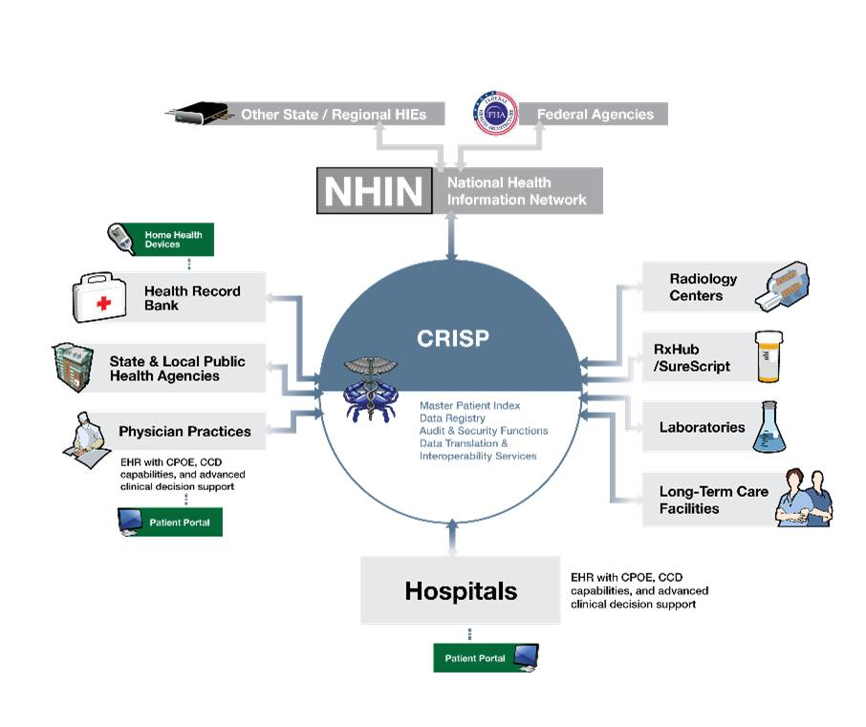
HIE among Local, Regional and National Level
Notes:
CRISP is a cooperative effort led by Erickson Retirement Communities, Johns Hopkins Medicine, MedStar Health, and the University of Maryland Medical System. Its primary purpose is to pursue opportunities for cooperation which can increase the availability of electronic medical information to treating clinicians.

Slide 10
References:
What is NHIN connect and NHIN Direct?
http://www.healthdatamanagement.com/news/interoperability-connect-nhin-direct-hie-40313-1.html
2. How to connect EMR to HIE?
http://hienetworks.com/2012/07/connecting-the-dots-of-emrs-and-hie/
3. An Overview of NHIN
www.ibm.com/developerworks/web/library/wa-nhindirect/wa-nhindirect-pdf.pdf

