Slide 1
Integrating Telemedicine into Healthcare Delivery
Group 3 – Final Project
Kazi Russell, Dave Seidman, Rebecca Traina
MED_INF 401-DL: American Healthcare System
Notes:
MED INF 401 DL Group 3 Final Project Slides – Kazi Russell, Dave Seidman, Rebecca Traina
Integrating Telemedicine into Healthcare Delivery

Slide 2
What is Telemedicine?
Definition:
“The delivery of health care services, where distance is a critical factor, by all health care professionals using information and communication technologies for the exchange of valid information for diagnosis, treatment and prevention of disease and injuries, research and evaluation, and for the continuing education of health care providers, all in the interests of advancing the health of individuals and their communities” (WHO)
Notes:
Modern telemedicine was first defined in 1970 as “healing at a distance”. Current telemedicine is continuously evolving as a result of new technology and changes in the overall healthcare system
Some examples of commonly used telemedicine technology include remote monitoring, mobile phones and other devices, online applications and tools, and audio/video systems.

Slide 3
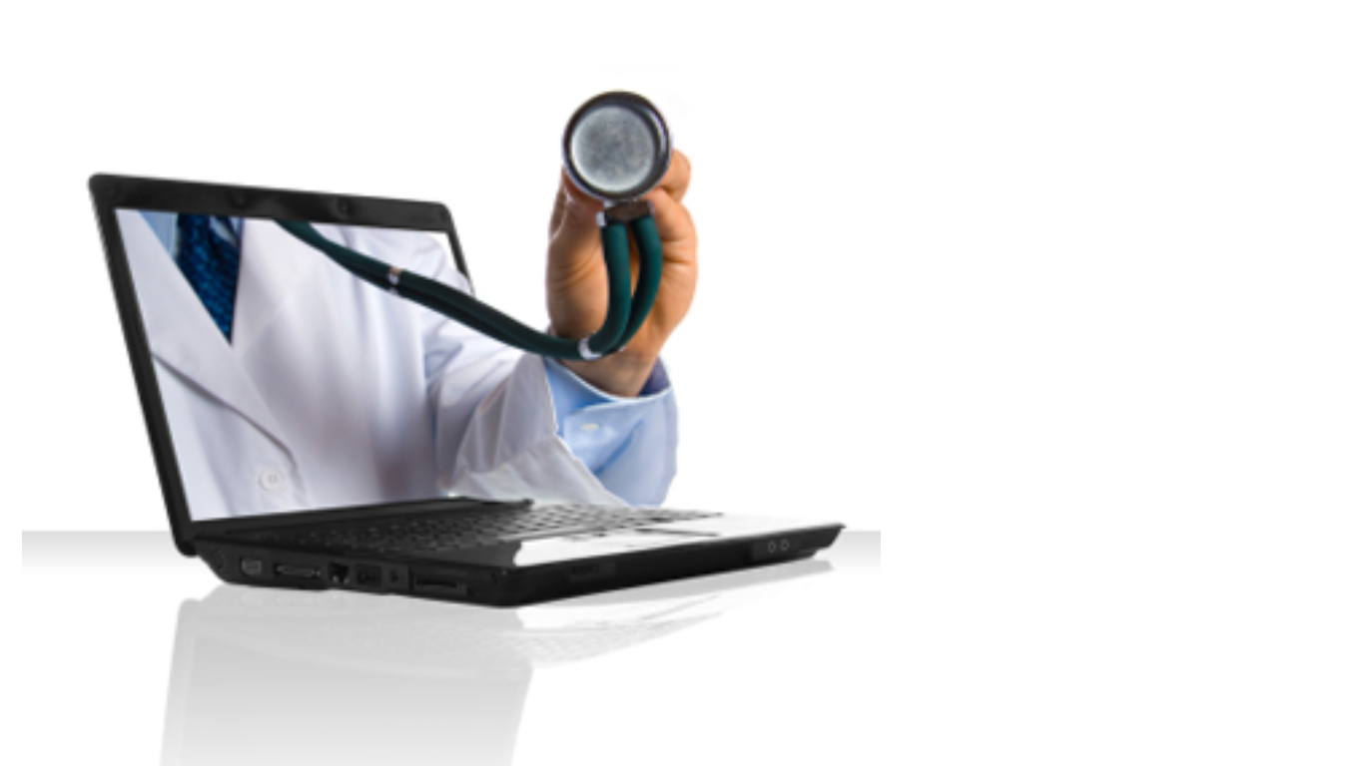
What is Telemedicine?
2 General categories
Asynchronous - “Store-and-forward”
Synchronous – “Real time”
4 Key Elements (WHO)
Who: Clinical support
What: User Connectivity
How: Wide variety of Information and Communication Technologies (ICT)
Why: Improvement of health outcomes
Notes:
Telemedicine generally falls into two distinct categories. “Store-and-forward” technology is asynchronous, meaning that information is recorded and exchanged back-and-forth with some time lapse between. An example of this would an email question-and-answer discussion between a provider and patient. “Real time” or synchronous telemedicine are tools that allow a live data exchange. A video consultation between a physician and patient would be an example of this type of interaction.

Slide 4
Background of Telemedicine
Stages of Emergence
Early Telemedicine: Very few public and private supporters
Modern Telemedicine:
1965-1973: Federal funding for research (short-term)
1973-1979: Expert evaluation by social scientists and healthcare organizational researchers
Early Telemedicine
1877: Telephone exchange
Late 1800s: EKG sent via telephone wires
First major research initiative – Rural Papago Advanced Healthcare program
Modern telemedicine
1960s – Military/Space programs
1970s – Still very expensive
1990s – Video teleconferencing (VTC)
Notes:
Telemedicine can be traced back as early as the late 1800s, when physicians utilized a “telephone exchange” to quickly contact a nearby drugstore, as well as sent electrocardiograph information over telephone wires. The first major research initiative, which lasted 20 years, was know as the “Rural Papago Advanced Healthcare” program. This program leverage telemedicine to help deliver care to a remote Indian reservation.
Modern telemedicine began in the 1960s, when in general funding was limited to applications with federal military and space sectors. Additional programs began appearing in the 1970s, but most did not last. However, there were a few very successful implementations using early telemedicine technology. One of these cases is Alaska’s “radio medical network”. This program used providers in remote locations of Alaska known as “health aides”, who contacted physicians in larger towns via radio for “assistance during medical encounters and instruction on treatment”.
Video teleconferencing emerged in the 1990s as a new approach that could be used in the healthcare setting. Although VTC had its beginnings outside of the healthcare realm, the technology has numerous “clinical applications”.

Slide 5
Background of Telemedicine
Recent Developments
Digital communication, Internet
Data exchanged in various mediums including “text, audio, video, or still images”
Mobile and Remote monitoring devices
Less expensive/more highly available by general public
Major categories include teleradiology and telepathology
Current Market Penetration
Not widely adopted yet
Routinely offered on limited basis in industrialized regions
Less developed countries – used for referrals to specialists and other care settings
Notes:
Emergence of the internet and digital forms of communication have led to a proliferation of new telemedicine technologies. Web-based applications such as “teleconsultations”, email, and “digital video and images” are some examples of recent developments. Remote monitoring devices such as heart rate tracking systems and glucose monitors are opening up possibilities for more home-based care. The availability of mobile devices such as smartphones and tablets have increased the accessibility to telemedicine by consumers around the world.
Currently, telemedicine is not yet widely adopted, as some payers believe the technology will increase expenses without necessarily improving quality of care. However, although not broadly utilized, telemedicine is nonetheless “routinely offered in industrialized regions” such as the United States, Australia, the U.K., and others. In less developed countries, telemedicine has been leveraged to connect “health-care providers with specialists, referral hospitals, and tertiary care centers”.

Slide 6
Current Payer Acceptance/Reimbursement
Medicare
Teleradiology and telepathology are billable services
Telemedicine generally covered only at rural locations
2014: Telemedicine for “transitional care management and chronic care” now reimbursed
Reimbursement for services often limited by provider type
Medicaid
45 states have some coverage; varies by state
“State Practice Acts”
Increasing in adoption
Private Payers
20 states and D.C. have passed “parity” legislation
Examples:
California – prohibits requirement of in-person visits that can be provided via telemedicine services
Oklahoma – reimburses for chronic care screenings done via telemedicine consultations
Notes:
Medicare generally approves new CPT (Current Procedural Terminology) codes for reimbursement only “a few at a time” (1). That said, Medicare’s published 2014 Fee Schedule includes several new billable telemedicine codes, as well as an increase in reimbursement to $24.63 (from $20 in 2011).
Medicare covers teleradiology and telepathology services, but for other telemedicine services, coverage has been limited to locations considered “rural” (1). The definition of a rural area has expanded in 2014, to include areas defined by the Office of Rural Healthy Policy (5). Rural locations used to be “strictly-defined” to “counties that are not part of a metropolitan statistical area”. Even with these new revisions, designated Rural Health Clinics sometimes fall outside the boundaries for reimbursement, causing pushback by providers.
CMS is working on the creation of a website for provider assistance in determining whether they are eligible to provide telemedicine services (5). This should also help in education around the type of providers/care locations eligible for reimbursement. For example, Skilled Nursing Facilities (SNFs) are now able to bill for telemedicine encounters (1).
45 states have adopted some form of telemedicine coverage under Medicaid, and this is only broadening. For example, Ohio has legislation in process to begin reimbursement of telemedicine services (4). Medicaid coverage of telemedicine varies by state. Some differences include reimbursement amount, “patient and provider eligibility”, types of technology that are covered, informed consent mandates, and patient distance to a facility (3).
For those that have passed legislation around telemedicine coverage, “State Practice Acts” (SPAs) must be followed. (2) Some items under SPAs include mandates that a provider have a “practicing license for the state in which the patient is located”. (2) Another example would be states that pay for “technical support, transmission charges, and equipment” of telemedicine services as fee-for-service rates or administrative costs. (2) If an SPA does not reimburse telemedicine encounters at the same rate as in-person visits, a separate SPA must be submitted. States that have limited coverage (for example, specific provider types only) “must ensure face-to-face encounter access for providers where telemedicine is not available”. (2)
Parity legislation mandates that private payers reimburse telemedicine encounters at an equal rate as face-to-face services. (1)
However, requirements are unique to each state. (1) For example, California (3) has “no legal prohibitions to using technology…as long as the practice is done by a California licensed physician. Telemedicine is not a telephone conversation, e-mail/instant messaging conversation, or fax; it typically involves the application of videoconferencing or store and forward technology to provide or support health care delivery”. Oklahoma does not include telephone or fax messages under the umbrella of “telemedicine”, but does prohibit the denial of telemedicine services by carriers.(3) Even without parity laws in place, many private payers cover some aspects of telemedicine.

Slide 7
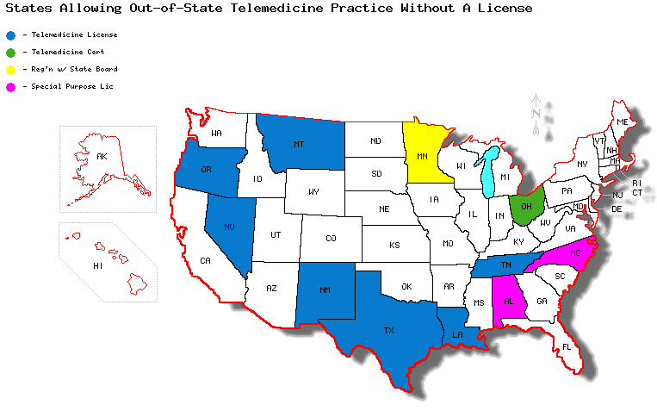
Telemedicine Licensure
Notes:
Summary of licensure to practice telemedicine across state lines
57 state medical boards (including the D.C. Board of Medicine, U.S. territory medical boards, and states boards that specifically regulate osteopathic medicine) require that physicians engaging in telemedicine are licensed in the state in which the patient is located (“Telemedicine Overview Board-by-Board Approach,” 2013).
Minnesota requires that physicians, both in-state, and out-of-state to register if they wish to practice telemedicine (“Telemedicine Overview.” 2013)
11 state boards have statutes that allow physicians licensed in another state to practice telemedicine without a standard medical license As of June 2013, 11 state medical boards “issue a special purpose license, telemedicine license or certificate, or license to practice medicine across state lines to allow for the practice of telemedicine” (“Telemedicine Overview.” 2013)
AL, LA, MN,MT, NC, NM, OH, OR, NV, TN, TX
“Special purpose” can be considered an umbrella term that a state medical board uses tto apply to circumstances where a physician is practicing in the state for a limited time or in a limited scope. (“Application for special permit/special purpose license,” n.d.)

Slide 8
Telemedicine Licensure
Current licensure requirements limit practitioners’ ability to treat patients across state lines, which hinders access to care.
American Telemedicine Association (ATA)
Federation of State Medical Boards
National Council of State Boards of Nursing
State Alliance for e-Health (part of the National Governors Association)
U.S. Department of Health and Human Services Health Resources and Services Administration (HRSA)
American Bar Association (ABA)
Federal Communications Commission (FCC)
Notes:
Many health care-related and non-health care-relate profession organizations see the need for licensure portability rules to be amended to reflect the increasing ability and need for the practice of telemedicine, to streamline the licensure process to enable practice of telemedicine across state lines. (Wakefield, 2010.)

Slide 9
Telemedicine Licensure
Proposals
ABA
Mutual telemedicine licensure recognition model
FCC
Licensure requirements recommendation via National Broadband Plan
HRSA
Uniform license application (UA)
Credentials verification organization (CVO)
Barriers to cross-state licensure
Acceptance of other states’ licensing criteria
Administrative costs
Technology costs
Notes:
The American Bar Association (ABA) proposes a “mutual telemedicine licensure recognition” model that would allow physicians to to file a single application to practice in any state provided they complied with state laws, regulations, and standards of medical care (Wakefield, 2010).
The Federal Communications Commission, in their 2010 National Broadband Plan, ncluded a section on state licensure requirements, which urged states to revise licensure requirements to enable “e-care” (Wakefield, 2010.)
The U.S. Department of Health and Human Services Health Resources and Services Administration Report to Congress Report recommends ways to increase cross-state licensure to remove one current barrier to Telemedicine:
A uniform licensure application (UA)–a single application for licensure that can be used by multiple states, thereby eliminating the requirement for a state specific application, while allowing for state unique requirements to be met through the use of addendum material to the uniform application” (Wakefield, 2010.)
A credentials verification organization (CVO), which “provides a service to the licensure applicant and state licensure authorities by obtaining and verifying the core documents and state specific requirements for licensure” (Wakefield, 2010.)
Barriers:
Some states medical boards are not unwilling to accept the licensing processes of other states. Boards want control over the criteria and requirements.
For instance, not every state board requires a criminal background check.
Expedited endorsements come at an additional administrative costs to states.
Technology is expensive; some states lack the IT capabilities to implement such recommendations.
(Wakefield, 2010)

Slide 10
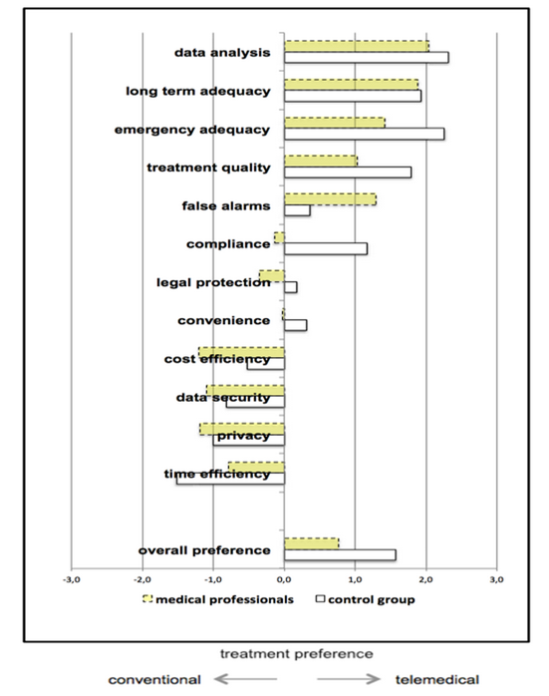
Physician Attitudes On Telemedicine
Notes:
Figure 3. From "Acceptance of Telemedical Treatments–A Medical Professional Point of View”. by M. Ziefle, L. Klack, W. Wilkowska, & A. Holzinger, 2013, Human Interface and the Management of Information. Information and Interaction for Health, Safety, Mobility and Complex Environments, p. 331.
The figure compares physicians attitudes towards telemedicine based on 13 different criteria, versus a control group of assorted other working professionals (not patients). As this particular demonstrates, physicians have more negatives views than non-physicians on almost every aspect of telemedicine, though they still have an overall preference for telemedicine versus conventional medicine.
Their biggest concerns are around cost efficiency, data security, and privacy.

Slide 11
Patient Attitudes On Telemedicine
Comparing attitudes of African Americans and Latinos
African Americans
Advantages
Reduced waiting time
Immediate feedback
Increased access to specialists
Increased access to multiple medical opinions
Convenience for children and the elderly
Concerns
Privacy/confidentiality issues related to the presence of personal information on the Internet
Adequacy of telemedicine scopes to make accurate diagnoses
The physical absence of the physician specialist
Ability to monitor the specialist’s qualifications
Latinos
Advantages
Reduced waiting time
Immediate feedback
Increased access to specialists
Increased access to multiple medical opinions
Convenience for children and the elderly
Greater accuracy of diagnoses due to precision of computers
Avoiding poverty-related embarrassment and in-person physician interaction
Concerns
Privacy/confidentiality issues related to the presence of personal information on the internet, to a lesser extent
Adequacy of telemedicine scopes to make accurate diagnoses, to a lesser extent
Concerns about whether telemedicine would be available to uninsured/undocumented
Notes:
An interesting study looked at the attitudes of urban African American and Latino attitudes towards telemedicine. In the results, we see many of the similar perceived advantages and concerns that are found in other studies.
Commonalities:
Reduced waiting time
Immediate feedback
Increased access to specialists
Increased access to multiple medical opinions
Convenience for children and the elderly
Specific to African Americans
The physical absence of the physician specialist
Ability to monitor the specialist’s qualifications
And, to a greater extent than Latinos:
Privacy/confidentiality issues related to the presence of personal information on the Internet
Adequacy of telemedicine scopes to make accurate diagnoses
These reflect African Americans historically-rooted mistrust of the medical community, dating back over a century, compared to Latinos, who don’t have this historical mistrust.
Specific to Latinos
The benefit of avoiding poverty-related embarrassment and in-person physician interaction. The barrier between patient and doctor is perceived as a positive.
Concerns about whether telemedicine would be available to uninsured/undocumented.
(Sheba, Alison, & Richard, 2012)

Slide 12
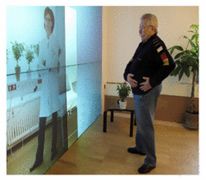
Patient Attitudes On Telemedicine
Expectations
Privacy
Cost
Convenience
Patients have a more positive attitude than doctors
Attitudes are consistent across age, gender
Specific benefits and concerns by race
Notes:
Patients have a more positive attitude about telemedicine that physicians.
Patients accept virtual appointments if the following
requirements are met:
• Only my doctor has access to my medical data.
• My medical data is kept safe from unauthorized access.
• I can speak with my doctor about personal topics.
• My insurance covers the costs for a virtual doctor’s visit completely.
• A doctor’s appointment for virtual visit is easier to organize than a
conventional visit.
• Learning to operate the system is easy for me.
• Overall, virtual visit is easy to use.
• Using the system must be pleasant. (Mennicken, Sack & Ziefle, 2011)
Overall, patients appreciate the benefits of telemedicine, independent of age and
gender (Mennicken, Sack & Ziefle, 2011).
“In contrast to outcomes in many other fields of technology usage,
in which there are distinct differences between younger and
older adults, this is not the case in this context. Also no gender
effects on acceptance were revealed” (Mennicken, Sack & Ziefle, 2011).

Slide 13
Meaningful Use for Telemedicine?
Meaningful Use for the EHR
Improve quality, safety, efficiency, and reduce health disparities
Engage patients and family
Improve care coordination, and population and public health
Maintain privacy and security of patient health information
No real inclusion for telemedicine as a component of the 3 stages of meaningful use
Data capturing and sharing
Advance clinical processes
Improved outcome
We’ve had four national coordinators for meaningful use, but we don’t have one for telehealth
Recommendation for Meaningful Use for Telemedicine
National coordinator for telehealth to create meaningful use guidelines for it or integrate into existing meaningful use guidelines
Notes:
The federal government’s healthit.gov site defines meaningful use as
Using certified electronic health record (EHR) technology to:
Improve quality, safety, efficiency, and reduce health disparities
Engage patients and family
Improve care coordination, and population and public health
Maintain privacy and security of patient health information
(“EHR Incentives and Certifications,” n.d.)
While meaningful use is a concept being used to certify electronic health record technology such that health providers are incentivized to adopt robust EHR solutions, a similar incentivizing certification program does not currently exist for telemedicine. It could be argued that the goals of telemedicine align with those of meaningful use.
However, as Neal Neuberger, executive director of the Institute for e-Health Policy and president of Health Tech Strategies, states there is "no real inclusion for telemedicine and telehealth" as a component of the three stage of meaningful use.
1. Data capture and sharing
2. Advance clinical processes
3, Improved outcome
(Millard, 2011)
In 2013, half of health care providers and three quarters of hospitals had adopted electronic records, less than three years after CMS incentive payments for meaningful use began. Telemedicine experts like Ryan Spaulding, director of telemedicine and telehealth at the University of Kansas Medical Center wonder this. “We’ve had four national coordinators for meaningful use, but we don’t have one for telehealth”. Spaulding recommends having a national coordinator for telehealth who could spearhead the creation of meaningful use for telehealth or integration of telehealth into the existing meaningful use guidelines (Bresnick, 2013.)

Slide 14
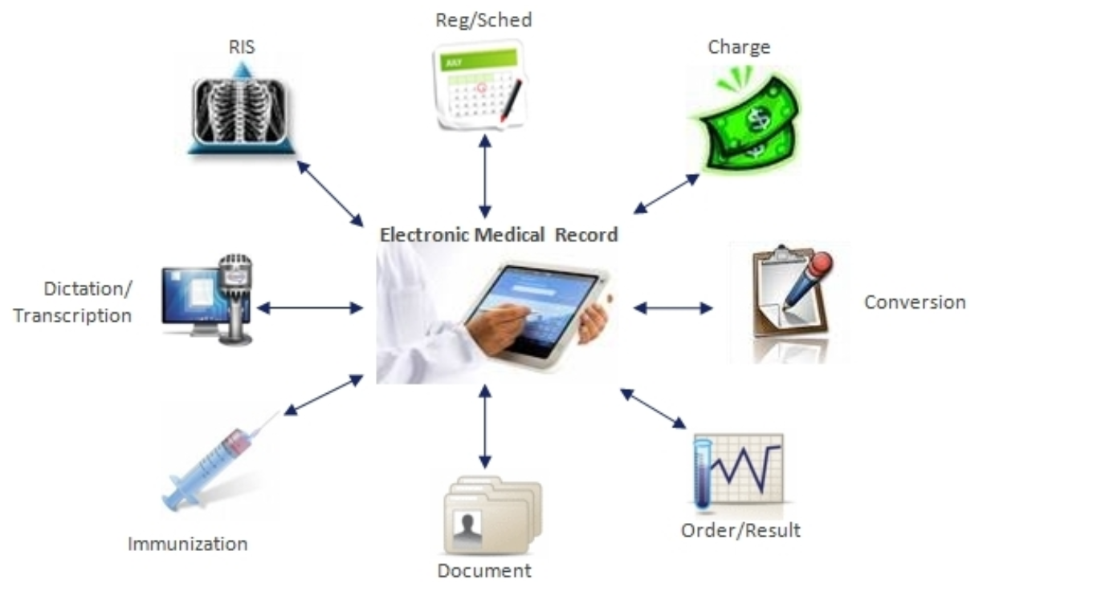
EHR Platform: Allscripts
Utilized by a variety of healthcare organizations and providers, including hospitals, post-acute care facilities, and ambulatory locations
“Open architecture” –connection to third-party vendors
CCHIT certified, meets Meaningful Use requirements
Recently announced partnership with American Well (Telemedicine corporation)
Launch date goal = January 2014
Notes:
Allscripts is currently utilized by over “180,000 physicians, 50,000 practices, 1,500 hospitals, and 10,000 post-acute care facilities (1). The company leverages technologies such as Microsoft.NET and employs an “open architecture” which allows easier integration with external systems. Allscripts recently partnered with the Telemedicine corporation American Well, to integrate their Online Care platform into Allscripts’ EHR architecture (2). Once in place, online video and audio consultations will be automatically incorporated into patients’ medical records (2).

Slide 15
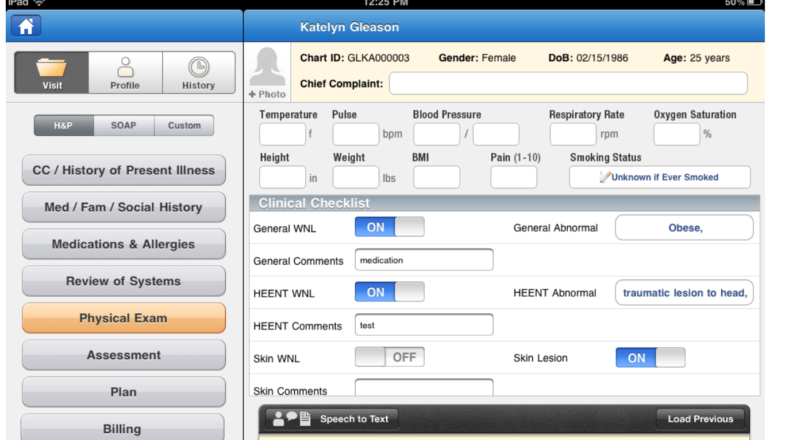
EHR Platform: EPIC
Founded in 1979
“Care Everywhere”: Physician controls what information is transferred across settings
“Lucy PHR”: Patient controls information sharing among providers and locations
EpicCare: “chart review, order management, and documentation”
Telemedicine already integrated into EPIC platform
EPIC for iPAD:
Notes:
EPIC is utilized around the country by a variety of “medical groups, hospitals, safety-net providers, and integrated systems”. (3) Some of the tools offered within the EPIC system include physician-controlled data transfer between care settings, known as “Care Everywhere” (3). A similar product is a patient-controlled data transfer known as “Lucy PHR” (personal health record). (3)
EpicCare incorporates speech recognition and system learning into a “chart review, order management, and documentation” system. (3).
The telemedicine functionality already integrated within the EPIC platform is suggested to result in both “patient engagement” and “cost-savings”. In fact, a case study at Stanford Hospital & Clinics is researching the effectiveness of online consultations scheduled via the hospital website, that are incorporated automatically into the EPIC EHR (known as “eCare”. (4) Some experts believe the telemedicine functionality within EPIC may cause other “electronic health vendors” to do the same. (4)

Slide 16
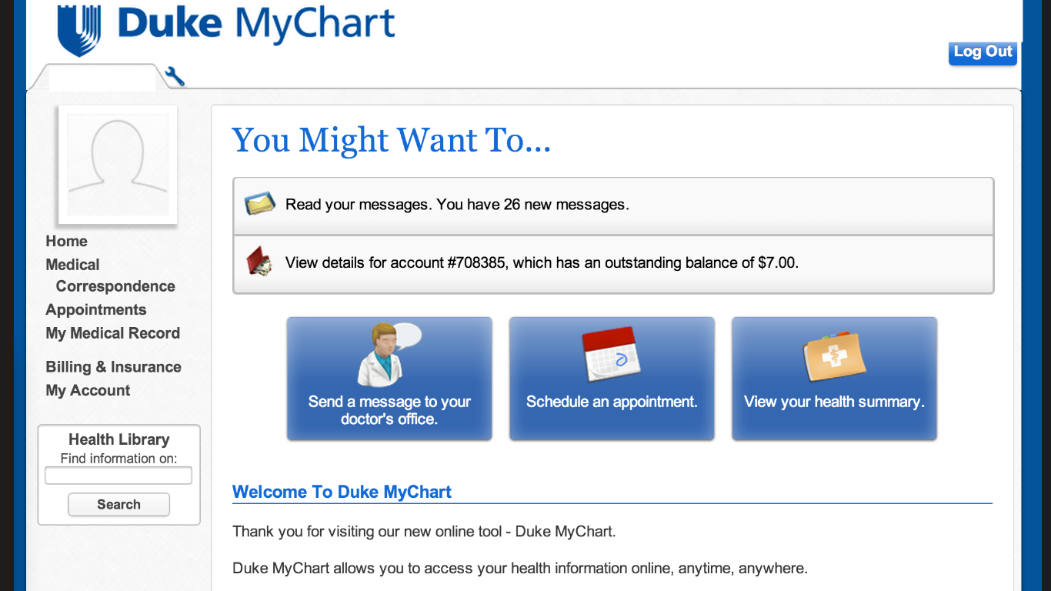
EHR Platform: EPIC
MyChart Patient Portal
Notes:
Patient portal data (MyChart) automatically integrated into EHR (3)

Slide 17
Telemedicine and EHR Integration
A healthcare provider who has a virtual encounter with a patient via telehealth should create an EHR for that patient.
Then the information can be ported over to a personal health record (PHR) that the patient can view on a portal that also allows communication with the provider.
The physician can use an HIE to share that information with other providers caring for the same patient.
Notes:
Meaningful use does not include much about telemedicine implementation. So Telemedicine providers are not even bothering to connect to physician EHRs. One main reason is lack of interoperability among disparate vendors.

Slide 18
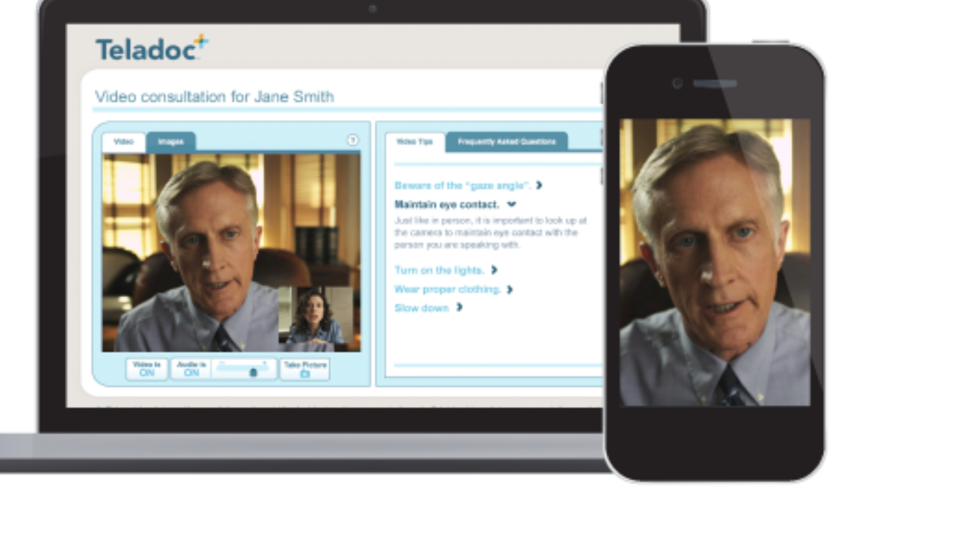
Telemedicine Platform: Teladoc
Network of physicians offering phone/web-based consultations
“One of the largest telemedicine providers in the U.S.”
2103: 6 million members, 12,000+ consultations
24-hour access to providers
Pros:
Easily used - basic technology
Inexpensive - $38/”visit”
Care not limited to specific issues/conditions
Cons:
Phone encounters may limit diagnostic ability
Patient’s medical record not accessible to Teladoc providers
Patient symptoms/reason for seeking care not submitted with request for care
Notes:
Teladoc is one of the earliest telemedicine platforms, and one of the largest in the United States. Teladoc has partnered with both insurance companies and employers for a shared goal of improved patient access to care and decreased healthcare costs.
Teladoc provides 24-hour a day access to a network of providers, who perform patient consultations via web-based (video) or telephone (audio only) conferencing.
The initial step a patient must take is to register in the system and create a personal account into which they enter relevant medical details. One issue here is that the information could be skewed, inaccurate, or incomplete. The patient then requests a consultation when needed, along with the platform in which they would prefer to be contacted. A “matching physician” (usually selected based on being licensed in the patient’s state of residence) then reviews the patient’s medical information and contacts the patient within an average of 20-25 minutes. Once the physician has discussed the patient’s symptoms, a diagnosis is made, shared decision takes place regarding treatment and care plan options, and in some cases medication is prescribed and sent to the patient’s pharmacy of choice.
One benefit Teladoc offers over alternate care options such as retail clinics is that there is no limitation on specific types of symptoms or conditions treated, while retail clinics often offer only a narrow “menu of services”. Research is still needed to determine the quality of care provided by Teladoc; for example, cases may occur in which a physical examination is necessary for a proper diagnosis or more urgent treatment is required. However, a study of CALPers enrollees found that 21% of patients using Teladoc had not used any other form of healthcare benefits that year, suggesting improved access for patients who may not otherwise seek care. The study also found that patients with a Teladoc encounter had lower rates of follow-up visits for the same or similar conditions in other care settings.

Slide 19
Telemedicine Platform:
Online Video Tools
WebEX
GotoMeeting
Adobe Connect
Skype
Notes:
These types of web meetings can happen securely, whether they take place at the patient’s home, or patients are brought into satellite offices with high-quality telepresence. Then, instead of waiting for days or weeks for a health professional to travel to an area, or patients having to take time off traveling to big cities, care can be given almost immediately with less inconvenience.

Slide 20
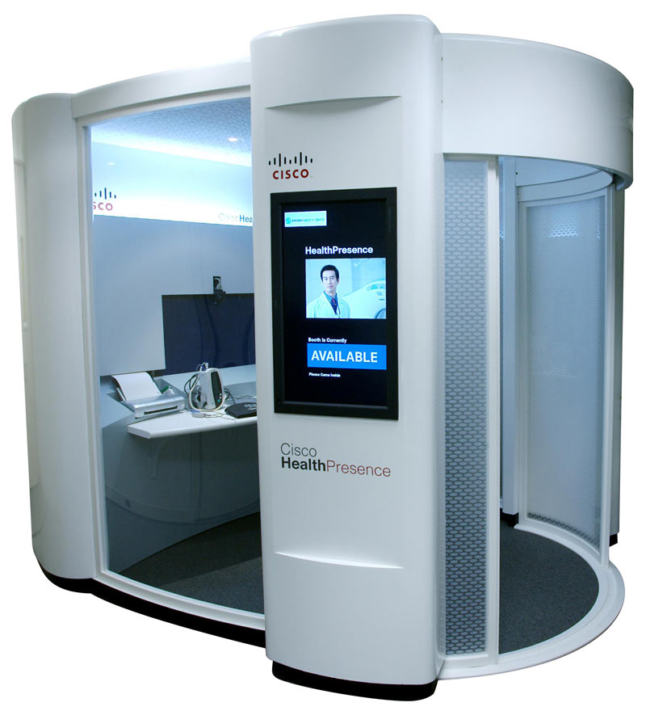
Telemedicine Platform: Cisco HealthPresence
Telehealth collaboration platform that addresses the needs of healthcare organizations by providing a mechanism for delivering healthcare to a greater number of patients and enables customers to build a scalable and flexible telehealth network that can enhance productivity and improve clinical workflows.
Notes:
(Musgrove, 2012.)

Slide 21
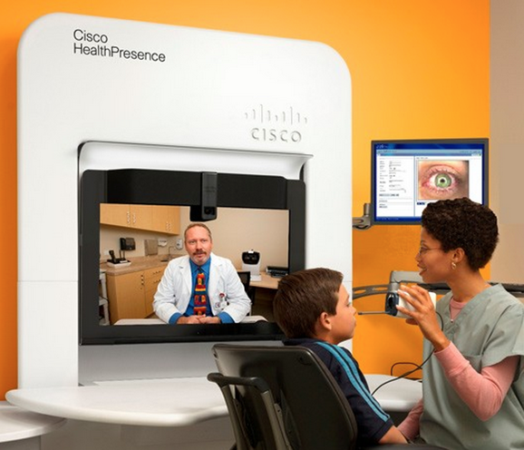
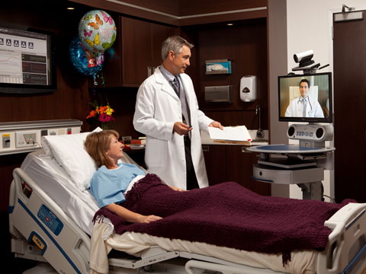
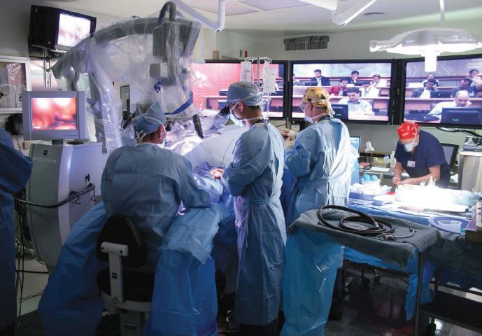
Telemedicine Platform: Cisco HealthPresence
High-definition videoconferencing
Remote Physician Exams
Specialist Consultations
Medical Education
Notes:
HealthPresence most well-known feature is the high-definition videoconferencing it provides, where the most common use case is to allow patients to be examined remotely by a physician. Other common use cases: remote patient consultations with specialists and medical education. (Musgrove, 2012.)

Slide 22
Telemedicine Platform: Cisco HealthPresence
Basic Technology
Full-HD 1080p capability
Video hardware used at attendant and provider locations can be Cisco endpoint or third-party endpoint
Connects to third-party medical devices using standard connectors (USD, S-Video)
HealthPresence Connect software
Cisco HealthPresence Connect Server at a data center provides communication links with HealthPresence endpoints and connected medical devices over encrypted private or virtual private network connections
Notes:
(“Cisco HealthPresence 2.5 Solution Design Guide,” 2012.)

Slide 23
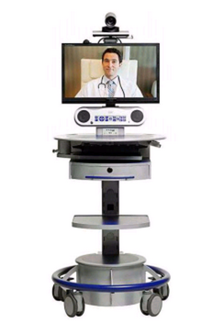
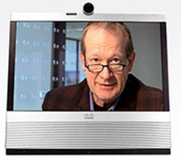
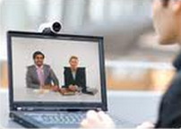
Telemedicine Platform: Cisco HealthPresence
Endpoint Examples
EX-90
CTS-500-32
VX Clinical Assistant
Jabber Video
Notes:
Cisco HD endpoints range from a simple webcam attached to a laptop running the Jabber client to a large-screen HealthPresence suite like the CTS-500 (“Cisco HealthPresence 2.5 Solution Design Guide,” 2012.)

Slide 24
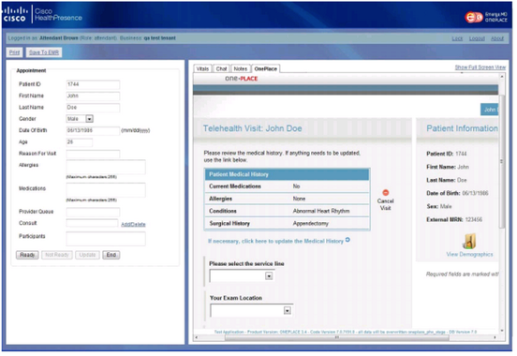
Telemedicine Platform: Cisco HealthPresence
Integration with any EMR
5 prebuilt connectors
Others can be custom developed
Patient information retrieved with click of a button
Example of an integration with OnePlace
Notes:
Designed for integration with any EMR
Five prebuilt connectors for use with OpenEMR and Mirth.
The connectors are licensed for use with available for an additional licensing fee.
(“Cisco HealthPresence 2.5 Solution Design Guide,” 2012.)
Can integrate with other EMRs as well, using custom-developed connectors.
Provide access to Electronic Medical Records (EMR) systems so that patient information can be retrieved from or sent to those systems from the Cisco HealthPresence appointment window with a click of a button.
(“Cisco HealthPresence 2.5 Q&A,” 2012.)

Slide 25
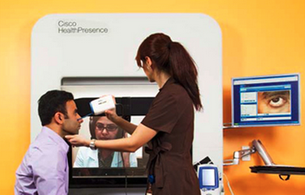
Telemedicine Platform: Cisco HealthPresence
Session Example
Nurse attends to patient
CHP transmits medical device data to remote care provider
Patient Vitals
Streaming video of exam camera, scopes
Stethoscope audio of heart and lungs
Notes:
Telehealth session example:
Patient attended to by a licensed healthcare professional (i.e. an RN)
Cisco HealthPresence transmits medical device information gathered during a telehealth session
CHP software receives information from the medical devices used by the attendant, and transmits that information to a remote care provide
Examples of how remote care provider can evaluate patient from the data provided from medical devices:
● View patient vitals
● View streaming video from an exam camera or medical scopes
● Listen to heart and lung sounds from a remote digital stethoscope
The specific medical devices and the data they make available will depend on local regulations and the configuration of the patient endpoint.
(“Cisco HealthPresence 2.5 Q&A”, 2012)
.

Slide 26
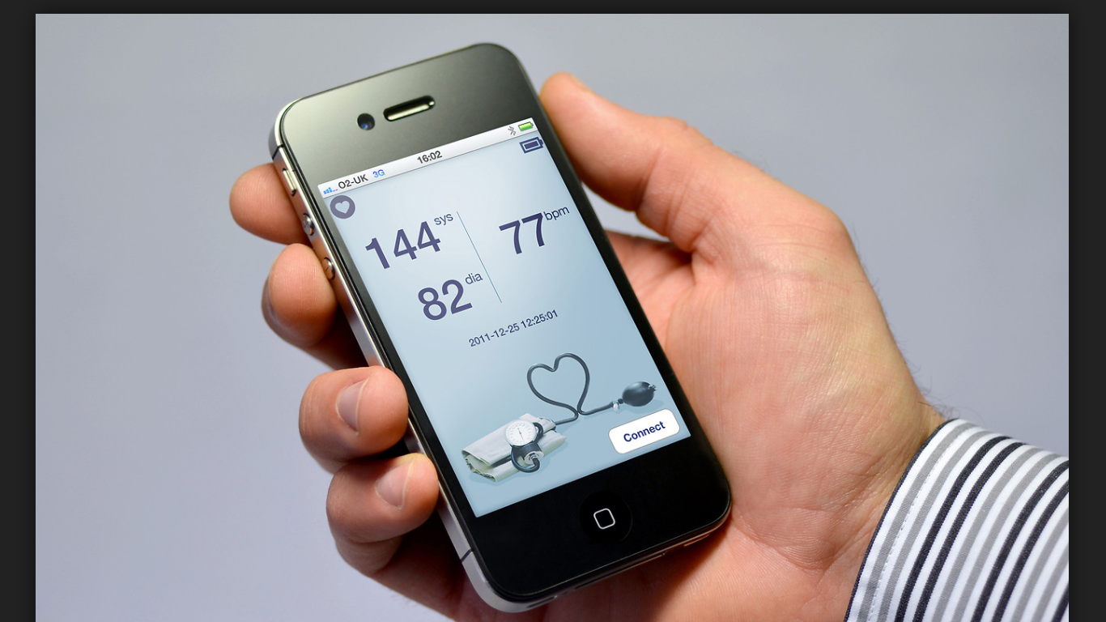
Telemedicine Platform: mHealth
Mobile Health: “mHealth”
“Recent proliferation of wireless and mobile technologies”
Smartphones and other mobile computing devices
Consumer demand for health apps and sensors
Over 2/3 of adults worldwide own mobile phones
“Rapidly and widely adopted among virtually all demographic groups”
U.S. - Rural areas = 82% Urban areas = 99%
Notes:
Mobile Health (known commonly has mHealth) has great potential to shift the landscape regarding the location and timing of how healthcare services are provided. The emergence of this technology allows information to be captured real-time via environmental and biological sensors that produce data on “an individual's biology, psychology (attitudes, cognitions and emotions), behavior, and daily environment”. This live data capture could provide opportunities to improve health outcomes and reduce patient risk.
The increasing availability of mobile technology, such as smartphone, and mobile computing devices, only enhances these opportunities. “96% of the United States is covered by at least one mobile network”, and worldwide, the percentage is growing.
Some of the information mHealth is able to obtain regarding patients include their daily physical activities and periods of rest, location, “physiological responses”, and body position. mHealth could be leveraged for population health purposes, such as mobile applications helps monitor and prevent falls at home, or that “help people who need medication to take them as scheduled”. A few issues that will need to be addressed as this technology expands in use include patient “privacy, confidentiality, regulatory control, and interoperability among carriers”.

Slide 27
Telemedicine Platform: mHealth
National Institutes of Health (NIH)
The Exposure Biology Program
Supports “development of environmental sensors”
Biomarker development and gene-environment interaction
mHealth Institutes
Provide background and introduction to mHealth technology
Focus on the social and behavioral aspects of mHealth applications
mHealth Training Listserv
mHealth-Training@list.nih.gov
Notes:
The National Institutes of Health fund several programs which seek evaluate and expand knowledge around mHealth. One such initiative, the Exposure Biology Program, seeks to test the effectiveness of environmental sensors for the “measurement of chemicals, dietary intake, physical activity, and psychosocial stressors and addictive substances”. The program also develops biological markers (“fingerprints“) that can be utilized to determine the interaction of genetics and environmental factors via mobile sensor monitoring.
The mHealth Training Institutes give providers the information needed to apply mHealth in the “behavioral and social” realms of public health. Week-long classes are offered with experts in which providers “create their own inter-disciplinary mobile health projects”. NIH also offers an mHealth Training listserv, which allows registered users to stay up-to-date on current events and new technology in this area.

Slide 28
Mental and Behavioral Health
Timely diagnoses by behavioral scientists via telehealth, for example, can help a child with autism in a rural community remain in school and improve socialization.
A quick check in via telehealth can help an older adult in a nursing home control her temper.
Notes:
APA’s Center for Workforce Studies has documented telehealth’s growth: Overall email use with clients for service delivery more than tripled among practicing psychologists from 2000 to 2008, with approximately 10 percent of those sampled using it weekly or more in 2008.

Slide 29
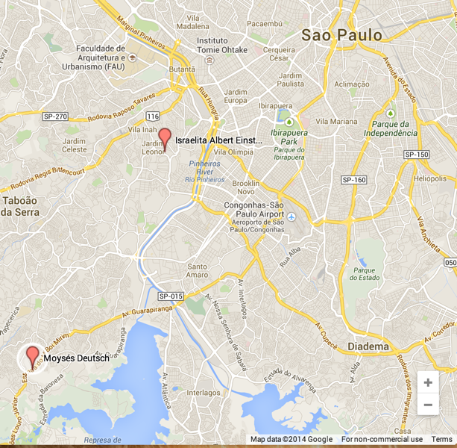
Telemedicine Case Study: San Paolo, Brazil: Specialists Consult with ICU/ER
Background
Pilot: Cisco mobile HealthPresence endpoints connect ICU and ER of public hospital and Telemedicine Center of private hospital
Israelita Albert Einstein (HIAE) (private)
Moyses Deutsch (HMMD) (public)
HIAE provides assistance from specialists when HMMD has none available or wants a second opinion
Notes:
Telemedicine pilot project at two hospitals in San Paolo, Brazil. used Cisco mobile healthcare telepresence endpoints to connect the ICU and ER of a public hospital and a Telemedine Center at a private hospital, in order to assist seriously ill patients if no specialists are available at the public unit or if a second opinion is required to provide a more extensive assessment.
Albert Einstein Israelita Hospital (HIAE) - private hospital (tertiary) with Telemedicine center
Hospital Municipal Moyses Deutsch (HMMD), a public hospital (secondary),
(Bueno De Souza, 2013)
Map: San Paolo Hospitals. (March 17, 2014). Google Maps. Google. Retrieved from https://mapsengine.google.com/map/viewer?mid=zR4Dsq8ZcwOU.k_e8ZF1TYCZg
.

Slide 30
Telemedicine Case Study: San Paolo, Brazil: Specialists Consult with ICU/ER
Study
Purpose: Evaluate efficacy of pilot
Results
Data obtained from 100 teleconsultations–74% from ICU
Most common reasons: Sepsis, stroke
TM improved diagnosis in 16.5% and influenced clinical management in 83.5% of the patients.
Life-saving TM interventions included stroke thrombolysis, limb amputation
Major of patients did not require referrals to other hospitals
Conclusion
Telemedicine-based intervention in a public hospital setting can avoid unnecessary transfers and improve real-time medical decision-making
Notes:
Study was done to evaluate the efficacy of this pilot.. “Results: Data were obtained from 100 teleconsultations (85 patients) records over a 4 months period. The majority of the requests originated from ICU (74.1%). Sepsis was the most common reason to access TM (29.4%), followed by stroke (24.7%). TM improved diagnosis in 16.5% and influenced clinical management in 83.5% of the patients. Life-saving TM interventions were stroke thrombolysis in 4 patients and a limb amputation in 1 patient. The majority of patients was discharged with no necessity of referring to another hospital.”
“Conclusion: The main contribution of telemedicine-based intervention is to avoid unnecessary transfers and to improve medical decision-making in a real time fashion.”
(Steinman, Abreu Filho, Alberto, Andrade, Helena, Guilherme Cal, ... & Silva, 2013)

Slide 31
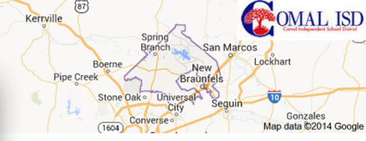
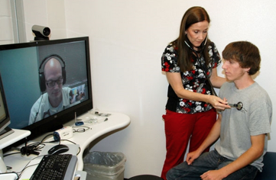
Telemedicine Case Study: Texas: Urgent Care Consult with School Clinics
Background
Resolute Health innovation lab came up with new model for student health in Texas school district
Deployed and Endpoint at school clinic and in urgent care center
School nurse attends to student
Doctor at the urgent care clinic remotely provides diagnosis, emails parents with prescriptions and discharge instructions
Notes:
Vanguard Health Systems operates 27 hospitals in five states. An arm of Vanguard called Resolute Health, which serves as their Innovation lab for coming up with new models in health care delivery. One such new model was implemented in the Comal, Texas independent school district, one of the state’s largest, where Resolute took over the operations of school clinics. Cisco HealthPresence endpoints were deployed in both the school clinics and in a Resolute Health urgent care clinic in New Braufels. The urgent care doctor emails parents with prescriptions and discharge instructions for students’ parents. Resolute Health is now implementing the same model locally for businesses and the county jail.
(CSCOPR, 2013)

Slide 32
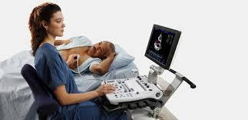
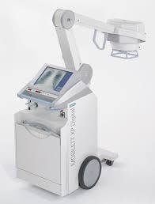
Mobile Ultrasound and X-ray

Slide 33
Case Study: Teleradiology ResMD Smartphone Telestroke Study
Teleradiology
“The practice of having medical images interpreted by a radiologist who is not present at the site the images were generated”
Images include x-rays, MRIs, ultrasounds
Used by hospitals, urgent cares, mobile imaging companies, private practices
Pros:
Inexpensive
On-site radiologists = start around $1500/day
Teleradiology = usually pay per exam, often as little as $8
Improved Access
Cons:
Information relay back to on-site doctors
Dependence on technology
Notes:
Radiology is an “imaging technique used by physicians to take images of the internal body, usually for diagnosis or treatment”.
Teleradiology has the potential to improve quality of care via the ability for patients to utilize radiology sub-specialists (such as neuroradiologists or MRI radiologists), who may not be accessible in certain locations and times.
Teleradiology has historically been used in emergency situations only, but has recently expanded. Image sending now is “as easy as sending an email with some attachments”. In addition to the benefits of collaboration with specialists who may otherwise be unavailable or inaccessible, teleradiology has the potential to improve diagnostics via second opinions, and improve symptom management for issues that might have been missed by a traditional radiology approach.
There are also some issues to keep in mind, such communication from off-site providers that might be miscommunicated or not received due to system glitches or other technology issues.

Slide 34
Case Study: Teleradiology ResMD Smartphone Telestroke Study
ResolutionMD (ResMD) Mobile
“Telemedicine solution provides instant access to images and reports via mobile devices”
Does not require patient image data to be stored on the device
Telestroke Study
Vascular Neurologists (VNs) utilized ResMD to view neuroradiological images of patients exhibiting signs of acute stroke
Rapid, easy access to images of patients at remote locations via telemedicine evaluation
Findings: Excellent agreement between VNs using ResMD and radiologists using standard Picture Archiving and Communication Systems (PACS)on noncontrast CT brain scans
Notes:
ResolutionMD (ResMD) is a technology that allows “rapid acess to interactive advanced 2- and 3-dimensional image visualization on Smartphone and tablet devices (Apple iOS or Google Android)”. The system supports “Wi-Fi and 3G/4G cellular data networks” in accessing these images, which are then transmitted to a remote location.
A telestroke study of ResMD versus independent radiologists using PACS found that “identification of the most critical radiological features on noncontrast CT brain scans such as intracranial hemorrhage, neoplasm, and any contraindications to thrombolysis was excellent.”

Slide 35
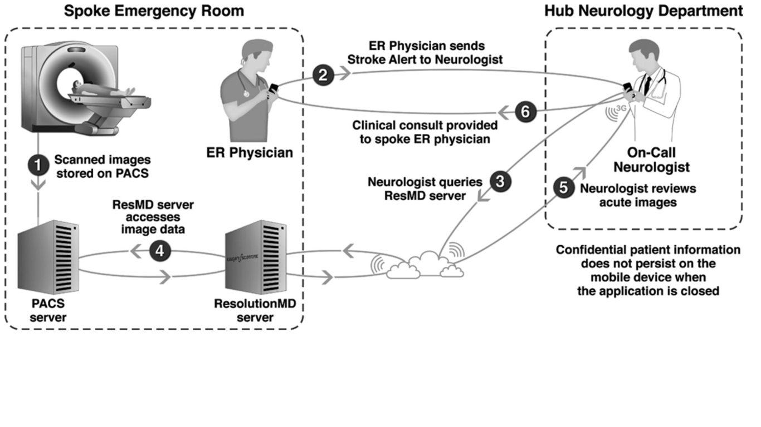
Case Study: Teleradiology ResMD Smartphone Telestroke Study
Notes:
-Depiction of the ResMD Smartphone Telestroke Study
-Sensitivity of the study = 94-97%
-Specificity = 100%
-Accuracy = 98-99%
-High “interrater agreement”

Slide 36
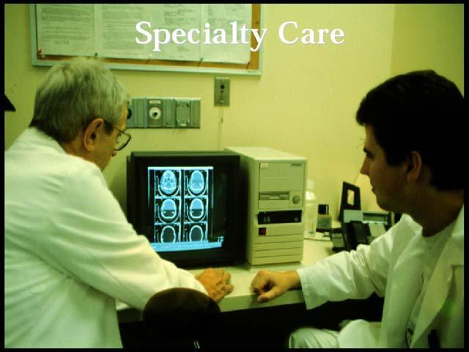
Remote Monitoring Devices
For:
Elder Patients
Better Chronic care management
Patients who are immobile
Serious illnesses
Notes:
These devices can transmit data to monitoring centers, which screen patients in different geographical areas. A nurse or other caregiver that can visit once a week or once a month to calibrate the devices.

Slide 37
Case Study: Insurance Companies eNeighbor Pilot
Background
Remote monitoring: “One of the fastest growing segments of the health IT industry”
Data can be sent to EHRs to provide ongoing picture of patient’s daily health
Humana and Healthsense Pilot Program
Elderly patients enrolled
Sensors placed in key locations around the home to measure routine daily activities
Goals:
Examine “effectiveness of home-based monitoring devices that may help senior citizens with complex needs or multiple chronic conditions”
Help trigger interventions and “prevent adverse events from escalating to emergency room visits or hospital stays”
Notes:
Remote monitoring of patients allows providers to determine potential risks or abnormalities in real-time. Humana partnered with Healthsense to study the effect of a “passive monitoring platform” in an elderly adult population. This program, known as eNeighbor, leverages home sensors that monitor the time a patient spends “sleeping, eating, and being mobile around the house”. The technology establishes patterns and monitors changes, so that alerts are automatically sent to clinicians “without the need for the patient to learn new technologies or check in with providers and family members”. The study is ongoing, and aims to determine if patients in this program are seen to “remain healthy and independent for longer” periods of time.

Slide 38
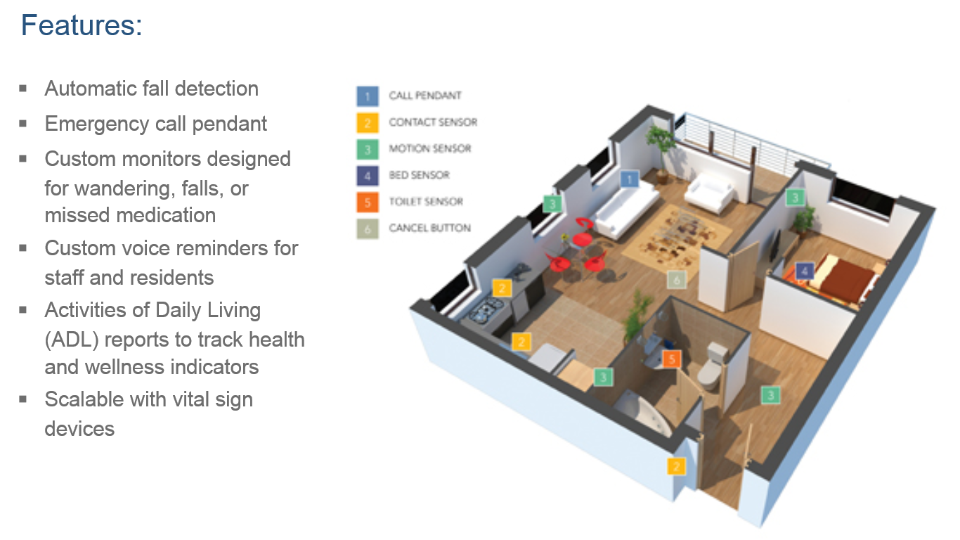
Case Study: Insurance Companies eNeighbor Pilot
Notes:
Features of eNeighbor Remote Monitoring Pilot Program.
-According to Humana: “With the information relayed to us from the Healthsense in-home sensors, we’re able to quickly act on the alerts we receive. This is especially important in cases where you have a member with multiple chronic conditions living alone and a timely response can drastically change a health outcome.”

Slide 39
Role of Telemedicine in Rural Healthcare
Rural healthcare system overview
Rural Telemedicine Delivery
Remote Monitoring Device
Remote Patient Diagnostics
Mental and Behavioral Health
Rural Telemedicine Challenges
Notes:
Telemedicine via telecommunications technology, has become an indispensable tool for rural hospitals to improve patient care and their bottom line. Telemedicine, just like every aspect of healthcare technology, is a business, and the financial benefits can't be ignored. Rural hospitals face a unique set of challenges when delivering quality care, and access to specialists is just one of them.

Slide 40
Rural HealthCare - Overview
Only 10% of US physicians practice in rural areas
Almost 25% of country’s population live in these areas
40 Specialists per 100,000 people in rural areas
134 Specialists per 100,000 people in urban areas
Notes:
With telemedicine, the PCP continues to be part of the patient's care even if a specialist is involved, because they are facilitating the virtual consultations and helping the patient make decisions.

Slide 41
Diagnostics of Rural Patients
Mobile imaging and lab center collects patient data
Data is sent electronically to base hospital’s diagnostics center
Diagnostic center reads and analyzes patient data
Results and reports are electronically sent to the rural care provider
Notes:
Patients in need of specialized care can often undergo diagnostic tests at mobile testing centers and have the results sent to specialists at a larger hospital. The specialist can review those tests in real time, or at his leisure, and then make a recommendation and consult for further treatment.

Slide 42
Rural Telemedicine - Challenges
Technology
Older patient’s technology fobia
Poor Data communication service
Lack of Standardization
Integration with EHR, CDSS, e
Interoperability among vendors
Data Analysis
Automation the reporting
Alerting the care providers at the right time
Notes:
There is little standardization among the remote monitoring devices because of the number of companies in the market, so IT faces an integration headache getting them working with existing EHR.

Slide 43
Summary
Concerns and Barriers
Difficult for physicians to practice telemedicine across state lines
Insurance coverage not widely available
Meaningful use standards not defined
Worries about privacy of personal information
Interoperability between disparate systems
Diagnostic limitations - unable to perform in-person examination
Benefits
Improved patient access: reduced need for travel, shorter wait times for appointments
Accessibility to specialists who may not practice in remote locations
Physician consultations, both in primary care and acute care settings that improve the quality of care
Improved efficiency of care–live data exchange, remote monitoring

Slide 44
References
A new emphasis on telehealth. (June 2013). Retrieved from https://www.apa.org/monitor/2011/06/telehealth.aspx
Allscripts. (2013). Why Allscripts? from http://www.allscripts.com/en/solutions/why-allscripts.html
AMD Global Medicine. (2014). Reimbursement for Telemedicine. from http://www.amdtelemedicine.com/telemedicine-resources/reimbursement.html
Application for special permit/special purpose license. Retrieved March 7, 2014, from http://www.ncmedboard.org/licensing/license_application/category/special_purpose_license_special_permit
Bresnick, J. (May 13, 2013). MU for mHealth? Why telemedicine should get better faster. from http://ehrintelligence.com/2013/05/13/mu-for-mhealth-why-telemedicine-should-get-better-faster/
Bresnick, J. (December 31, 2013). Humana begins remote monitoring, telehealth pilot. from http://ehrintelligence.com/2013/12/31/humana-begins-remote-monitoring-telehealth-pilot/
Notes:
Deck References

Slide 45
References
Bresnick, J. (February 4, 2014). Ohio passes Medicaid telehealth coverage law. from http://ehrintelligence.com/2014/02/04/ohio-passes-medicaid-telehealth-coverage-law/
Brino, A. (December 06, 2013). 2014 Physician Fee Schedule gives boost to telehealth. from http://www.medicalpracticeinsider.com/news/2014-physician-fee-schedule-gives-boost-telehealth
Bueno De Souza, A. (2013). Cisco Provides Telemedicine Technology for Albert Einstein Israelita Hospital in Brazil [Press release]. Retrieved from http://newsroom.cisco.com/release/1128798
Cisco HealthPresence 2.5 Q&A. (November 12, 2012). Retrieved C67-721625-00, from http://www.cisco.com/web/strategy/docs/healthcare/C67-721625-00_healthpresence_2.5_q_a.pdf
Cisco HealthPresence 2.5 Solution Design Guide. (November 12, 2012). Retrieved OL-27290-01, from http://www.cisco.com/c/dam/en/us/td/docs/solutions/Verticals/Healthcare/HealthPresence/Version_2_5/V2_5_Solution_Design/CHP2_5_Solution_Design_Guide.pdf
Notes:
Deck References

Slide 46
References
CSCOPR. (2013, January 17). Health care roundtable [Video file]. Retrieved from https://www.youtube.com/watch?v=otGdoJ9dVJc
Demaerschalk, B. M., Vargas, J. E., Channer, D. D., Noble, B. N., Kiernan, T. E. J., Gleason, E. A., ... & Bobrow, B. J. (2012). Smartphone teleradiology application is successfully incorporated into a telestroke network environment. Stroke, 43(11), 3098-3101.
EHR interoperability issues plague some telemedicine providers (05, 2013). Retrieved from http://searchhealthit.techtarget.com/news/2240185137/EHR-interoperability-issues-plague-some-telemedicine-providers
EHR Incentives and Certifications. (n.d.). Retrieved March 17, 2014, from http://www.healthit.gov/providers-professionals/meaningful-use-definition-objectives
Epic Systems Corporation. (2014). EPIC: About Us. from http://www.epic.com/about-index.php
Hospital EMR and EHR. (2005-2014). Stanford Uses Epic Feature To Conduct Web Visits. from http://www.hospitalemrandehr.com/tag/epic-telemedicine/
Notes:
Deck References

Slide 47
References
McCann, E. (August 15, 2012). Telehealth and Allscripts EHR, new dynamic duo. from http://www.healthcareitnews.com/news/telehealth-and-allscripts-ehr-new-dynamic-duo
Mennicken, S., Sack, O., & Ziefle, M. (2011, May). People and a virtual doctor's visit: Learning about multiple acceptance aspects of a telemedical scenario. In Pervasive Computing Technologies for Healthcare (PervasiveHealth), 2011 5th International Conference on (pp. 577-584). IEEE.
Millard, M. (May 4, 2011). Telemedicine left out of meaningful use, experts say. from http://www.healthcareitnews.com/news/telemedicine-left-out-meaningful-use-experts-say
Mun, S. K., & Turner, J. W. (1999). Telemedicine: Emerging e-medicine. Annual Review of Biomedical Engineering, 1(1), 589-610. doi:10.1146/annurev.bioeng.1.1.589
Musgrove, M. (2012). Cisco Enhances Healthcare Software and Service Offerings Designed to Enable Caregivers to Provide Higher Quality of Care [Press release]. Retrieved from http://newsroom.cisco.com/press-release-content;jsessionid=3DA8F534D980602C608C764FECAA61F3?type=webcontent&articleId=1129008
Notes:
Deck References

Slide 48
References
National Institutes of Health. mHealth - Mobile Health Technologies. from http://obssr.od.nih.gov/scientific_areas/methodology/mhealth/
Remote Monitoring Devices. (July, 2013). Retrieved from http://www.informationweek.com/mobile/remote-patient-monitoring-9-promising-technologies/d/d-id/1110968
Sheba, G., Alison, H., & Richard, S. B. (2012). How do low-income urban African Americans and Latinos feel about telemedicine? a diffusion of innovation analysis. Int. J. Telemedicine Appl., 2012, 1-1. doi: 10.1155/2012/715194
Steinman, M., Abreu Filho, C., Alberto, C., Andrade, V., Helena, A., Guilherme Cal, R., ... & Silva, E. (2013, February). Impact of Knowledge Transfer Through the Implementation of an Emergency Telemedicine Program in a Brazilian Community Hospital. In eTELEMED 2013, The Fifth International Conference on eHealth, Telemedicine, and Social Medicine (pp. 73-77).
Telemedicine: Emerging e-medicine. Seong K. Mun and Jeanine W. Turner. Annual Review of Biomedical Engineering, Vol. 1: 589 -610 (Volume publication date August 1999)
Notes:
Deck References

Slide 49
References
Telemedicine Improve Patient Outcome. (July, 2013). Retrieved from http://www.informationweek.com/mobile/telemedicine-improves-patient-outcomes-study/d/d-id/1111285
Telemedicine Overview Board-by-Board Approach. (June 2013). Retrieved from http://www.fsmb.org/pdf/grpol_telemedicine_licensure.pdf
Telemedicine Transforms Rural Care. (November, 2013) Retrieved from http://www.informationweek.com/healthcare/clinical-information-systems/telemedicine-transforms-rural-care/d/d-id/898921
Telemedicine, Telehealth and health IT. (May, 2006). Retrieved from http://www.americantelemed.org/docs/default-source/policy/telemedicine-telehealth-and-health-information-technology.pdf?sfvrsn=8
Notes:
Deck References

Slide 50
References
Uscher-Pines, L., & Mehrotra, A. (2014). Analysis Of Teladoc Use Seems To Indicate Expanded Access To Care For Patients Without Prior Connection To A Provider. Health Affairs, 33(2), 258-264. doi: 10.1377/hlthaff.2013.0989
Wakefield, M. (2010). Health licensing board report to congress: U.S. Department of Health and Human Services Health Resources and Services Administration.
Ways telemedicine can boost care in rural communities. (June, 2011). Retrieved from http://www.healthcareitnews.com/news/5-ways-telemedicine-can-boost-care-rural-communities?page=1
Weinstein, R. S., Lopez, A. M., Joseph, B. A., Erps, K. A., Holcomb, M., Barker, G. P., & Krupinski, E. A. (2014). Telemedicine, Telehealth, and Mobile Health Applications That Work: Opportunities and Barriers. The American Journal of Medicine, 127(3), 183-187. doi: http://dx.doi.org/10.1016/j.amjmed.2013.09.032
World Health Organization. (2010). ICD-10 Version:2010. from apps.who.int/classifications/icd10/
Notes:
Deck References

Slide 51
References
World Health Organization. (2010). Telemedicine: opportunities and developments in Member States: report on the second global survey on eHealth. World Health Organization.
Ziefle, M., Klack, L., Wilkowska, W., & Holzinger, A. (2013). Acceptance of Telemedical Treatments–A Medical Professional Point of View. In Human Interface and the Management of Information. Information and Interaction for Health, Safety, Mobility and Complex Environments (pp. 325-334). Springer Berlin Heidelberg.
Notes:
Deck References

